Slide 1

Install Selenium Webdriver

Slide 2
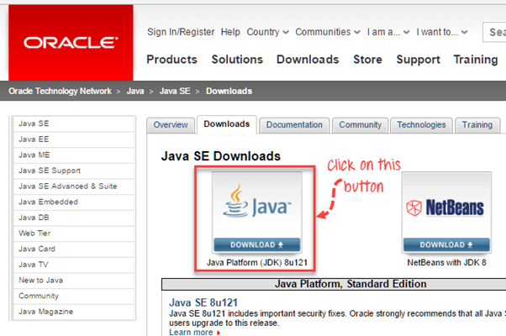
Install Java
Download and install the Java Software Development Kit (JDK).

Slide 3
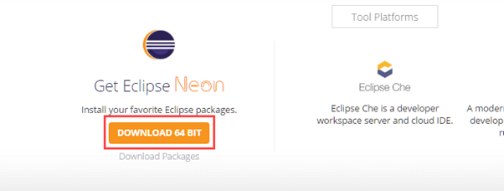
Install Eclipse IDE
Download "Eclipse IDE for Java Developers". Be sure to choose correctly between Windows 32 Bit and 64 Bit versions.

Slide 4
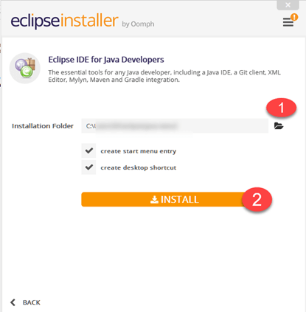
Install Eclipse IDE-2

Slide 5
Download the Selenium Java Client Driver
Download the Selenium Java Client Driver by choosing choose the one for Java.
For simplicity, extract the contents of this ZIP file on your C drive so that you would have the directory "C:selenium-2.25.0". This directory contains all the JAR files that we would later import on Eclipse.

Slide 6
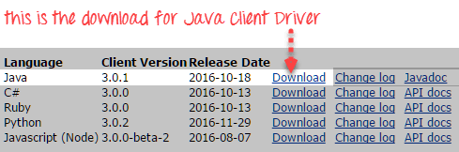
Download the Selenium Java Client Driver-2

Slide 7
Configure Eclipse IDE with WebDriver
1Launch the "eclipse.exe" file inside the "eclipse" folder that we extracted in step 2. If you followed step 2 correctly, the executable should be located on C:eclipse-eclipse.exe.
3.When asked to select for a workspace, just accept the default location.

Slide 8
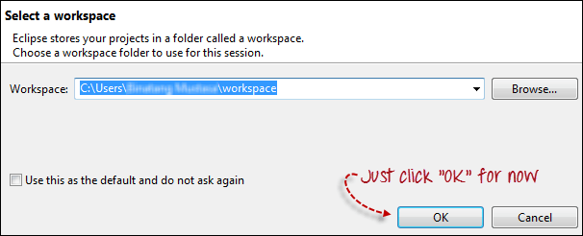
Configure Eclipse IDE with WebDriver-2

Slide 9
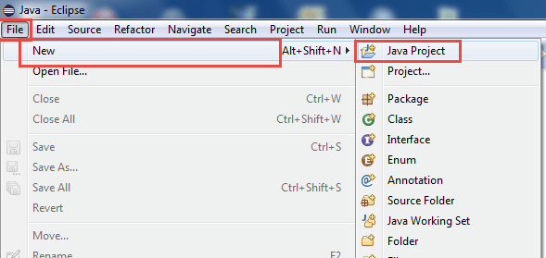
Create a New Java Project

Slide 10
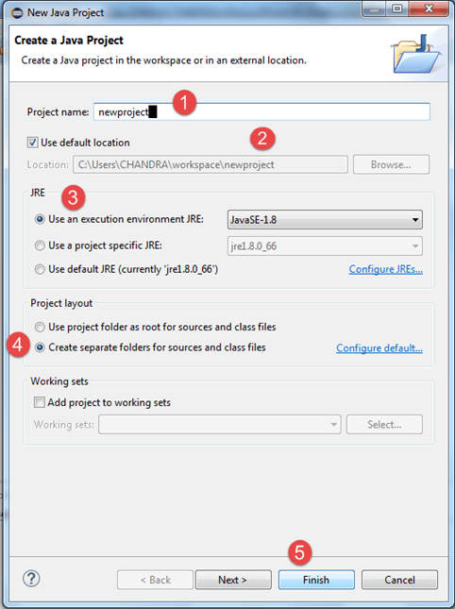
Create a New Java Project-2

Slide 11
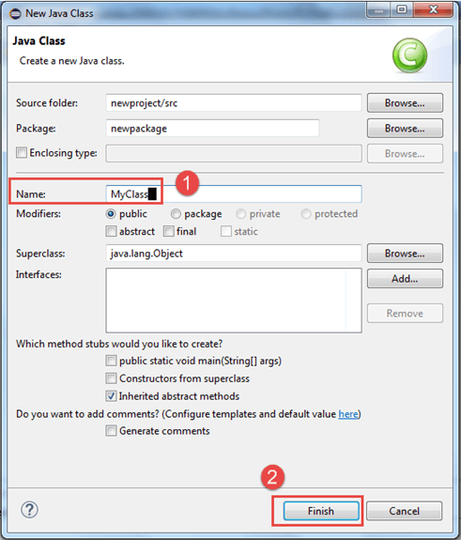
Create a Java Class

Slide 12
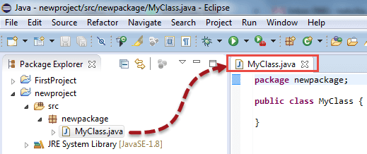
Create a Java Class-2

Slide 13
Add Selenium Jar
Right-click on "newproject" and select Properties.
On the Properties dialog, click on "Java Build Path".
Click on the Libraries tab, and then
Click on "Add External JARs.."

Slide 14
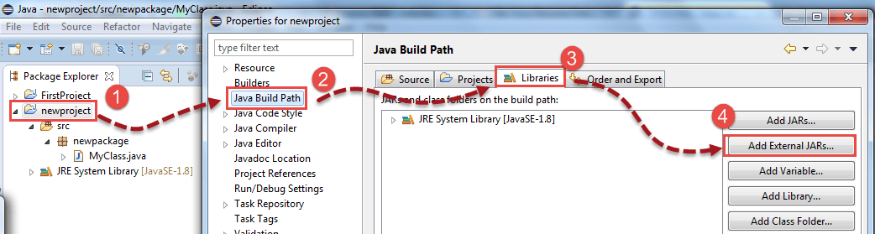
Add Selenium Jar-2

Slide 15
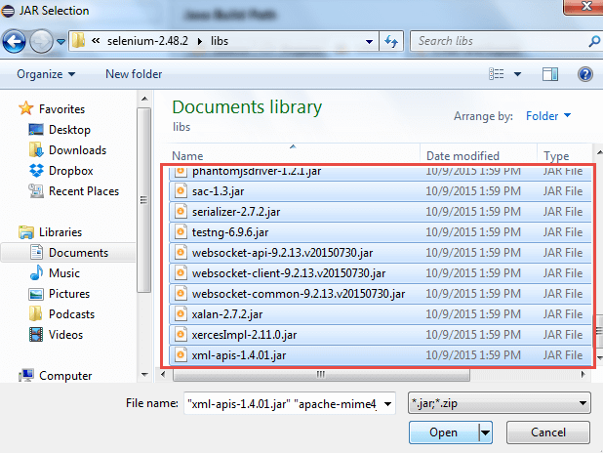
Add Selenium Jar-3

Slide 16
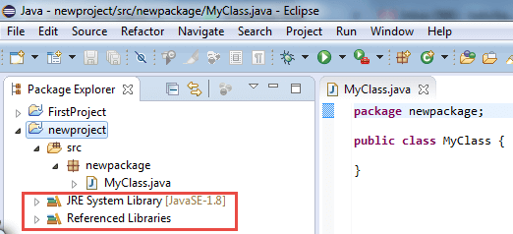
Add Selenium Jar-4
In the end it should appear like this

Slide 17
Thanks

